Slide 1
COVID-19 Dashboard Demo
Group 2
Jiaze E G42729067
Zeyuan Feng G45597386

Slide 2
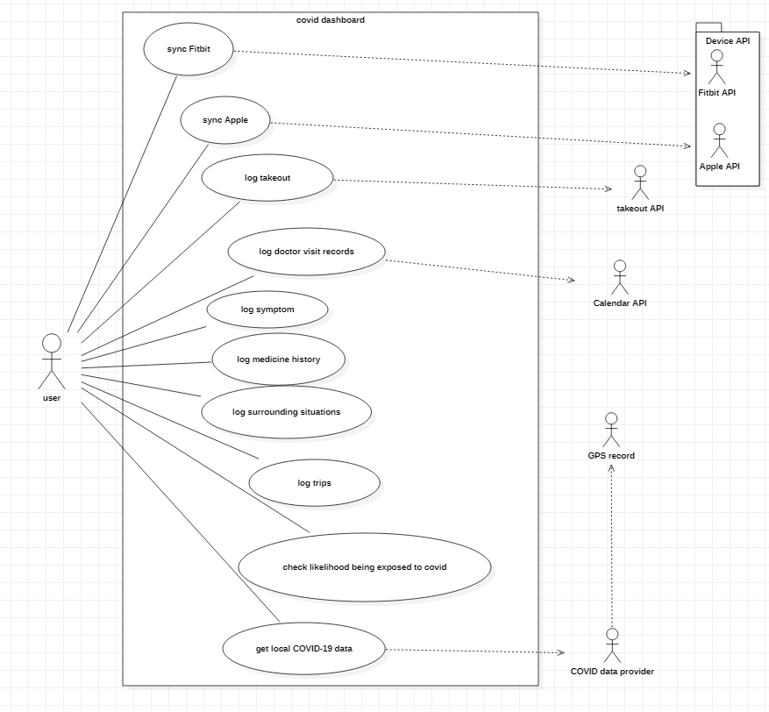
Use Case Diagram
multiplicity of user-to-usecases:
all 1…* for user, and 1 for use case
multiplicity of usecases-to-providers:
all 1 for use case and 1 for providers

Slide 3
Actors
user: the user who use the dashboard
Device API: provide biometrics data from Fitbit or Apple
Calendar API: provide doctor appointment records
GPS record: provide location records
takeout API: take out data from takeout applications
COVID data provider: provide COVID data

Slide 4
Use Cases
sync Fitbit and sync Apple: get biometric data from Device API
log takeout and log doctor visit records: provide functions to get takeout or doctor visit records by manually input or fetch from online services
log symptom, log medicine history, log trips and log surrounding situations: provide functions to get data by manually input so that users can record data into log database
check likelihood being exposed to covid: shows the possibility forecast computed by likelihood calculator depending on the data from database and device data API.
local COVID-19 data: provides a function to local COVID data from COVID data provider

Slide 5
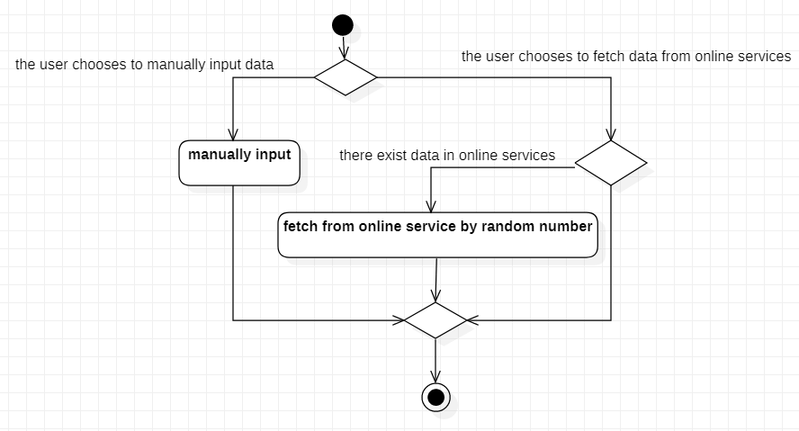
Activity Diagram
log takeout
log doctor visit records

Slide 6
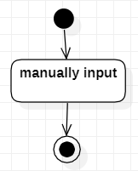
Activity Diagram
log symptom
log medicine history
log surrounding situations
log trips

Slide 7
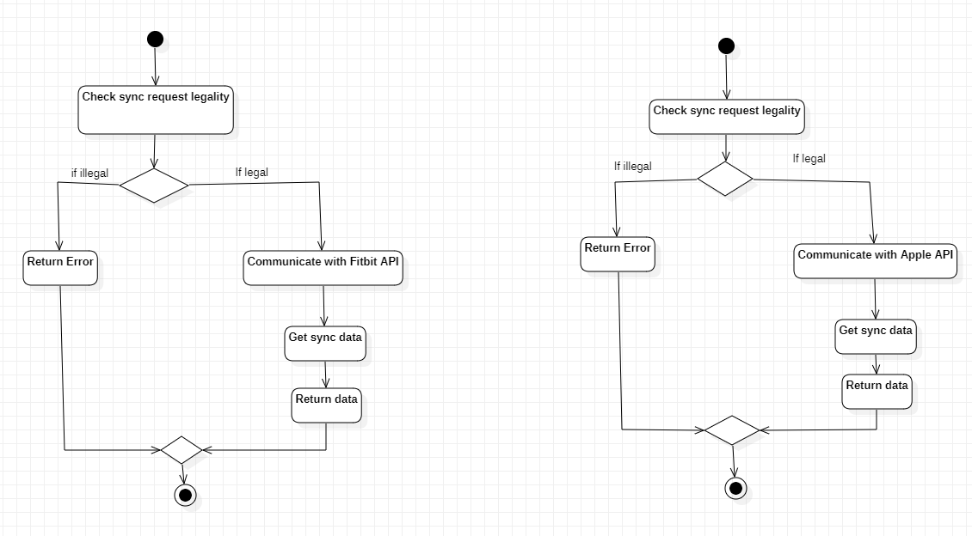
Activity Diagram
sync with Fitbit
sync with Apple

Slide 8
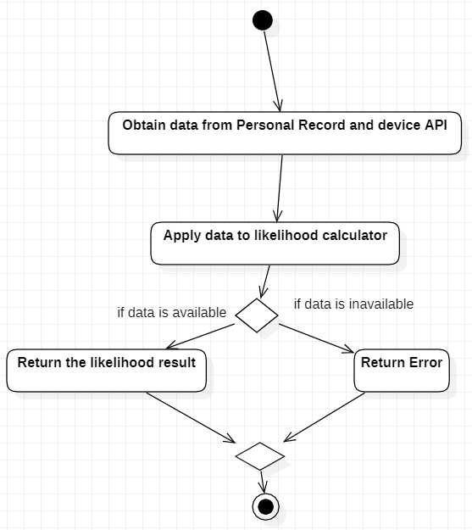
Activity Diagram
Check likelihood of having Covid

Slide 9
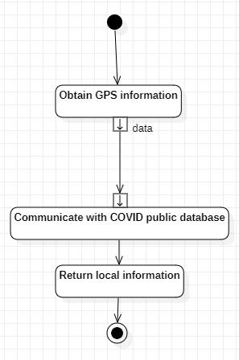
Activity Diagram
get local covid data

Slide 10
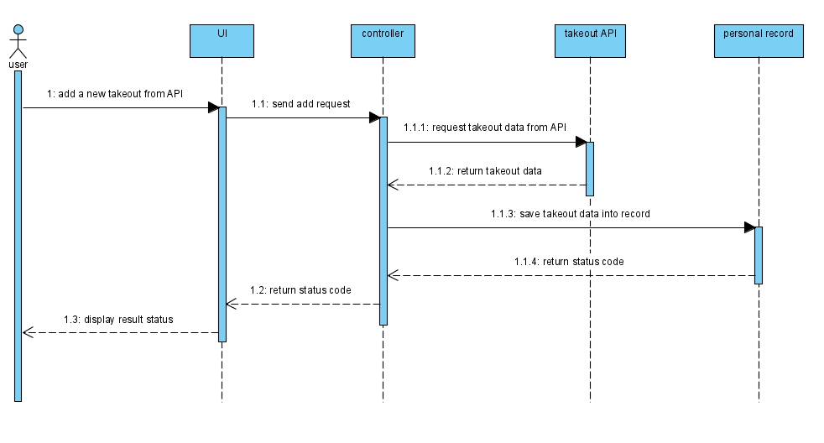
log data from online API

Slide 11
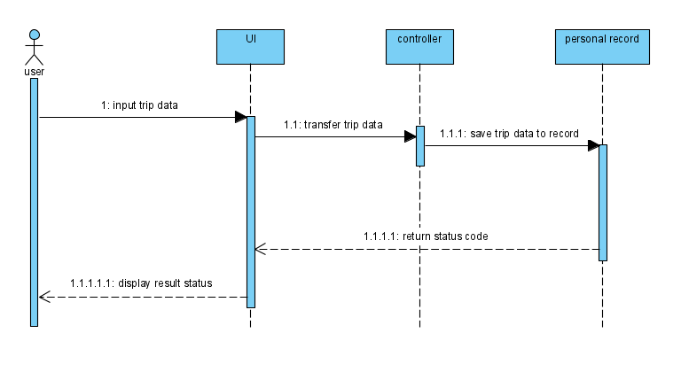
Log data from manually input

Slide 12
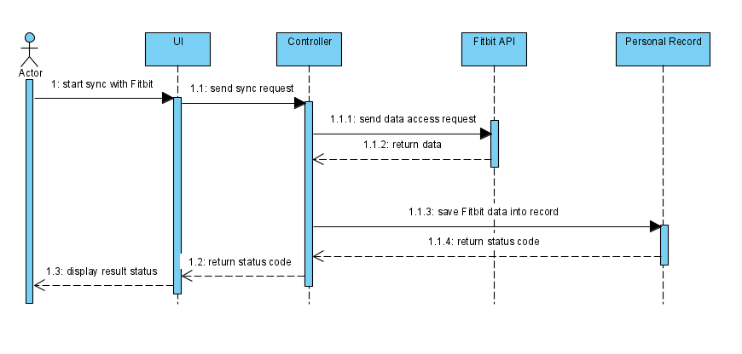
Sync with Fitbit

Slide 13
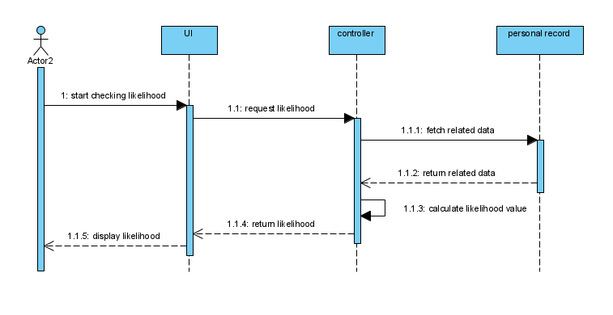
check likelihood being exposed to covid

Slide 14
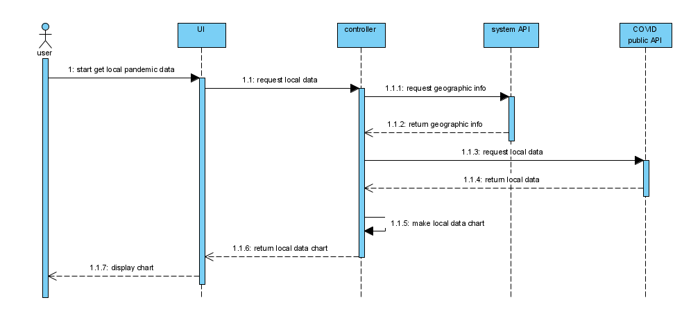
get local COVID-19 data

Slide 15
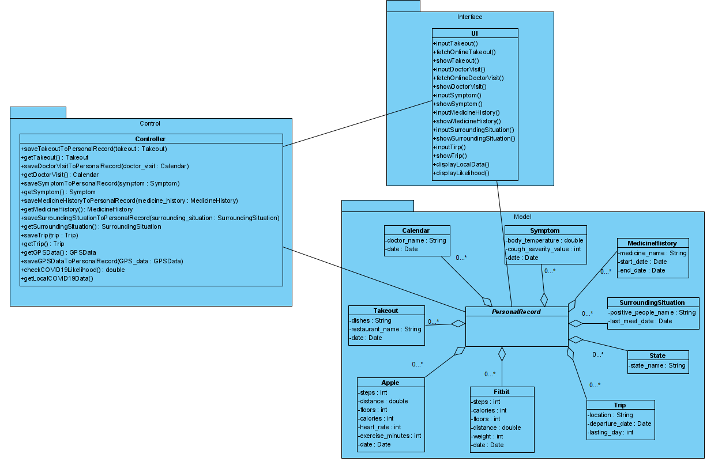
Domain Model

Slide 16
Domain Model vs MTV model
Model
View
Template
User
Database
Domain Model | Django MTV Structure | Functions
Model | Model | Create data model and interact with database
Interface | Template | Display frontend elements and interact with user
Controller | View | Manage backend logic and coordinate with different parts

Slide 17
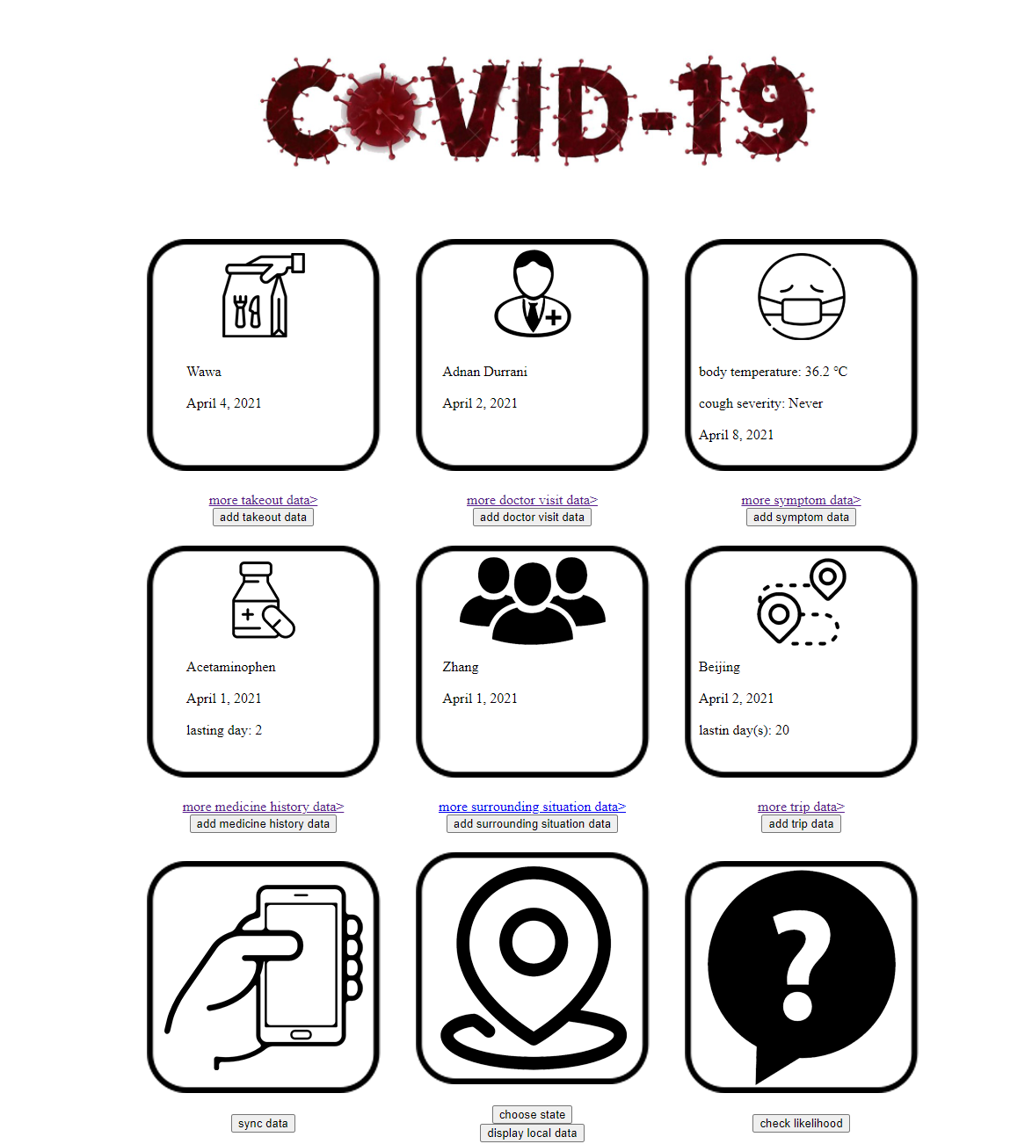
Live Demo

